Slide 1
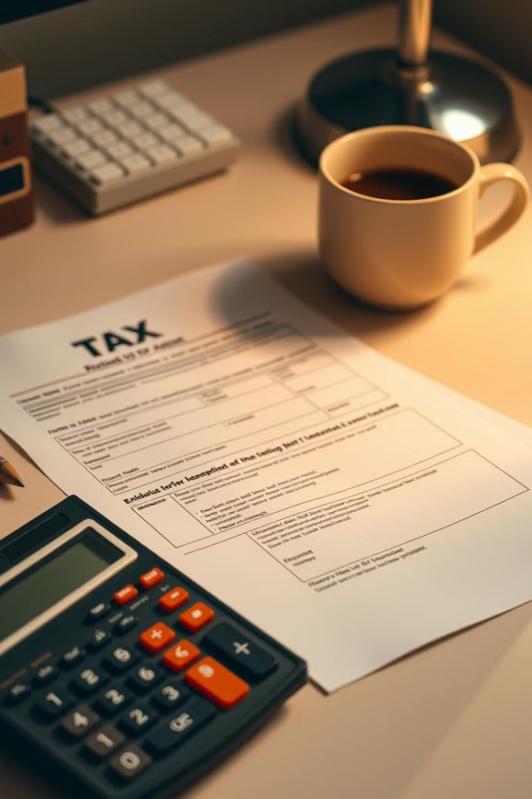
Income Tax Calculator App
The Income Tax Calculator App is a comprehensive tool that simplifies the process of preparing your annual tax return. With its intuitive interface and intelligent features, you can accurately calculate your taxable income, maximize deductions and credits, and confidently file your taxes.
Bv
by B.Nikhil Vardhan
192211805

Slide 2
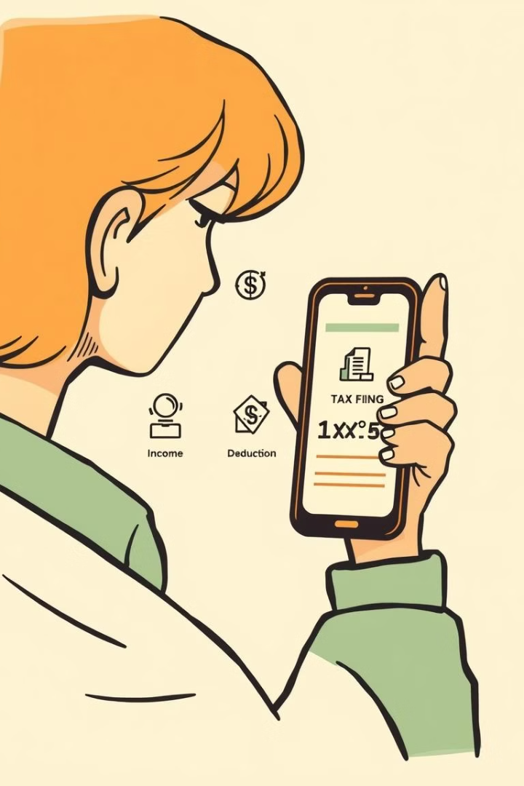
Key Features
1
Personalized Tax Calculations
2
Deduction Optimization
Input your income, deductions, and credits to get a tailored estimate of your tax liability.
Easily track and maximize eligible deductions and credits to reduce your overall tax burden.
3
Filing Assistance
Seamlessly navigate the tax filing process, whether you choose to file yourself or with a professional.

Slide 3

Calculating Taxable Income
Identify Income Sources
Calculate Taxable Income
Compile your W-2s, 1099s, and other income statements to accurately report your total income.
Apply deductions and credits to your total income to determine your final taxable amount.
1
2
3
Determine Deductions
Explore eligible deductions, such as mortgage interest, charitable contributions, and medical expenses, to lower your taxable income.

Slide 4
Deductions and Credits
Standard Deductions
Itemized Deductions
Tax Credits
Take advantage of the standard deduction, which reduces your taxable income by a fixed amount.
Explore a wide range of itemized deductions, such as mortgage interest, charitable donations, and medical expenses.
Claim eligible tax credits, which directly reduce the amount of tax you owe, such as the Child Tax Credit and Earned Income Tax Credit.

Slide 5
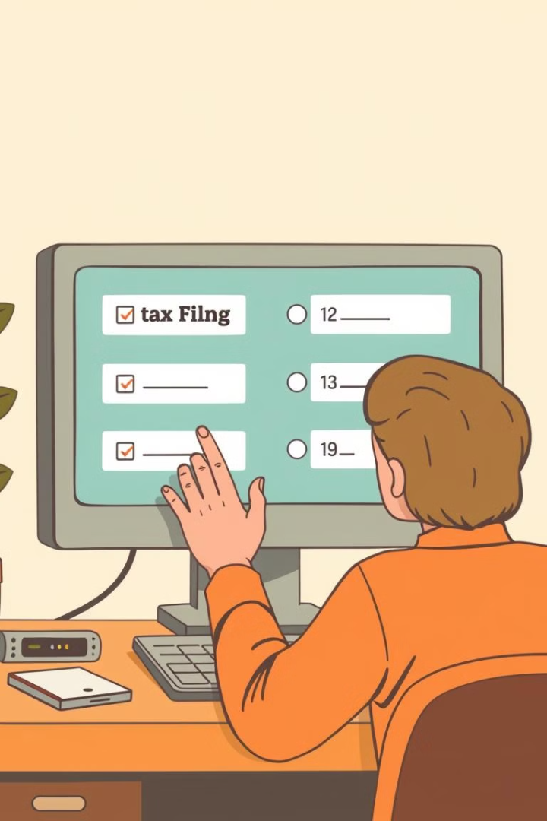



Filing Options
E-File
Conveniently file your tax return electronically for faster processing and a quicker refund.
Paper Filing
Opt to file your tax return by mail if you prefer a more traditional approach.
Professional Assistance
Work with a tax professional to ensure your return is filed accurately and you maximize your refund.

Slide 6




Conclusion and Next Steps
Download the App
Get the Income Tax Calculator App and start your tax preparation journey.
Begin Tax Preparation
Gather your tax documents and utilize the app's features to ensure an accurate and stress-free tax filing.
File with Confidence
Confidently submit your tax return, knowing you've maximized your deductions and credits.

